Slide 1
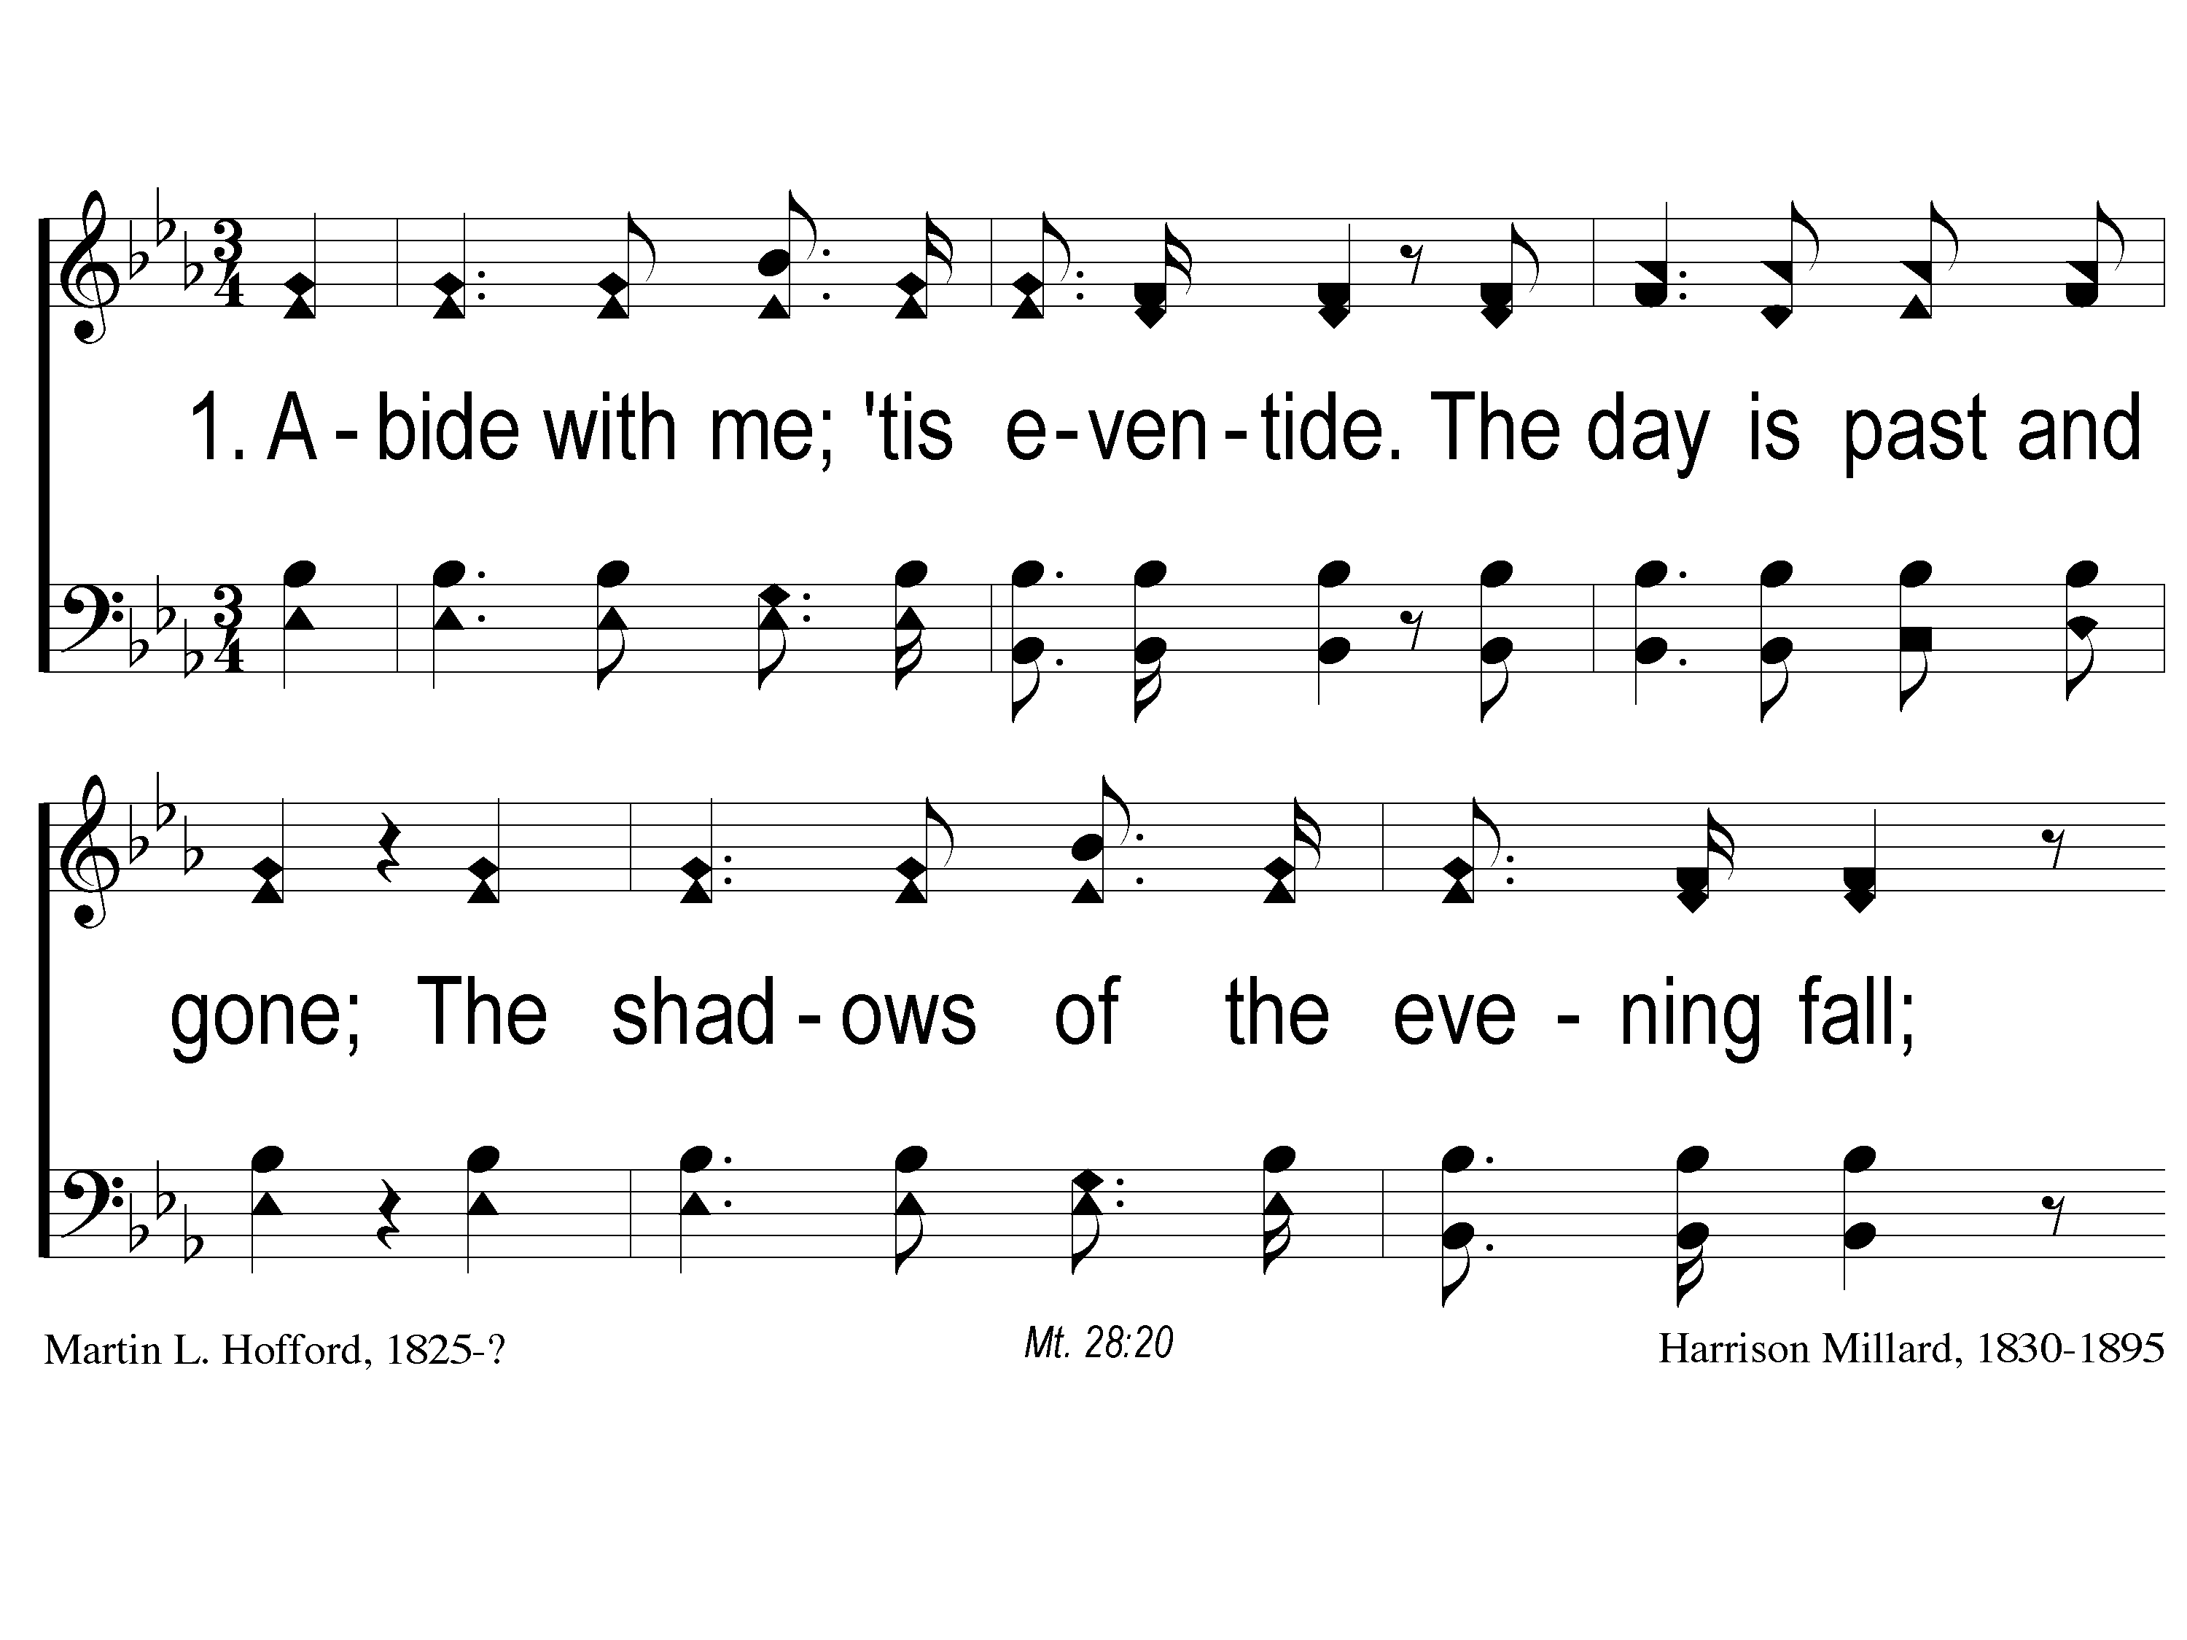
1-1 Abide with Me Tis Eventide
Abide With Me; ‘Tis Eventide
34
ePraise Hymn Presentation © 2005 Taylor Publications

Slide 2
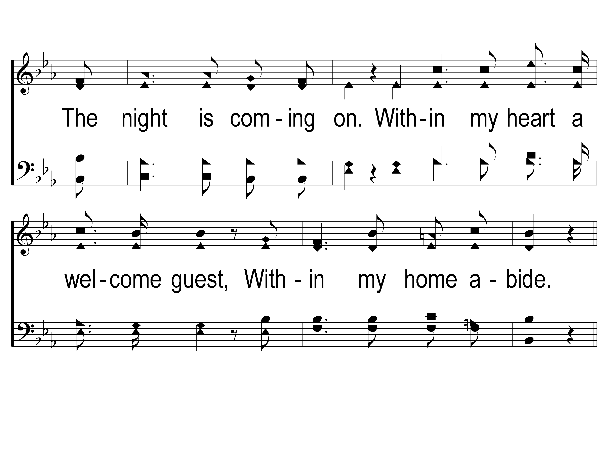
1-2 Abide with Me Tis Eventide
Abide With Me; ‘Tis Eventide
34
ePraise Hymn Presentation © 2005 Taylor Publications

Slide 3
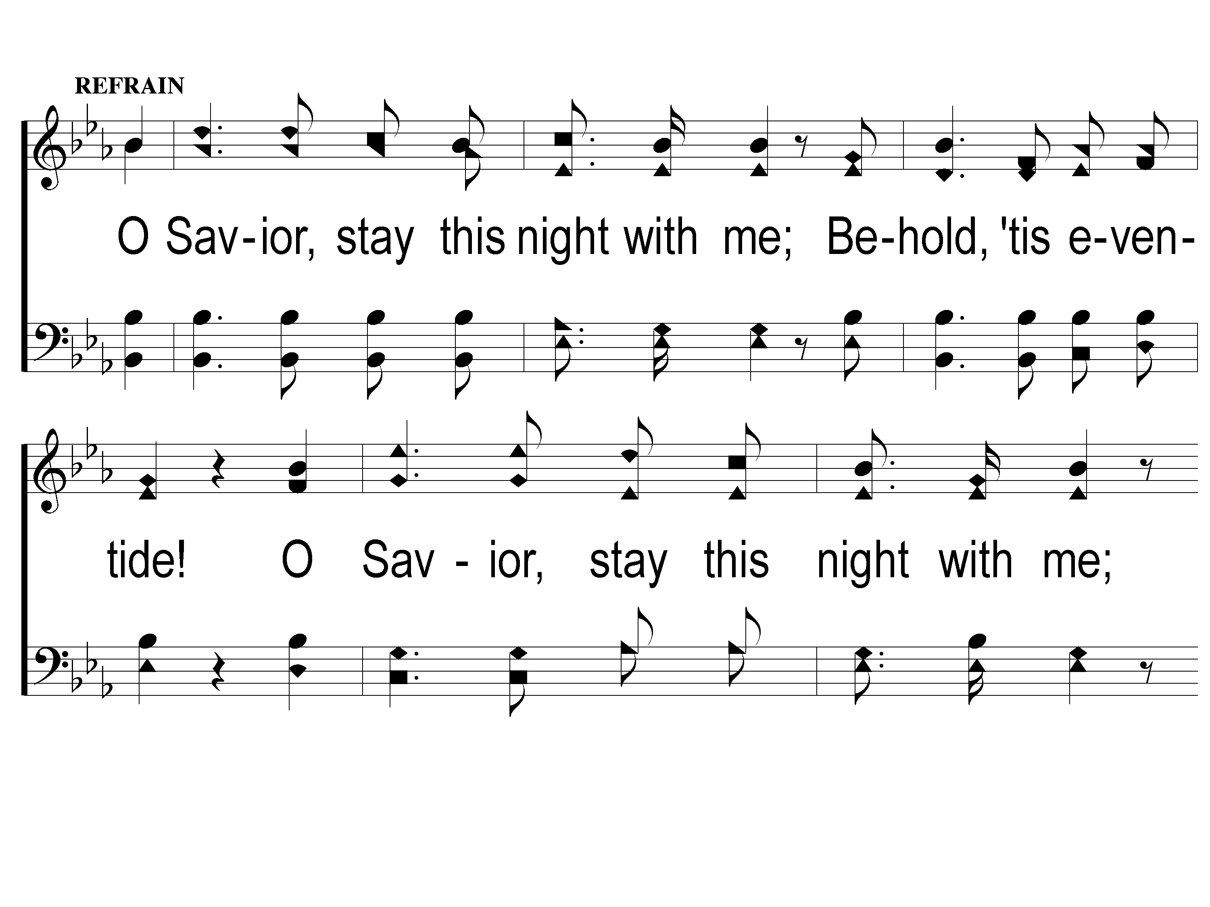
C-1 Abide with Me Tis Eventide
Abide With Me; ‘Tis Eventide
34
ePraise Hymn Presentation © 2005 Taylor Publications

Slide 4
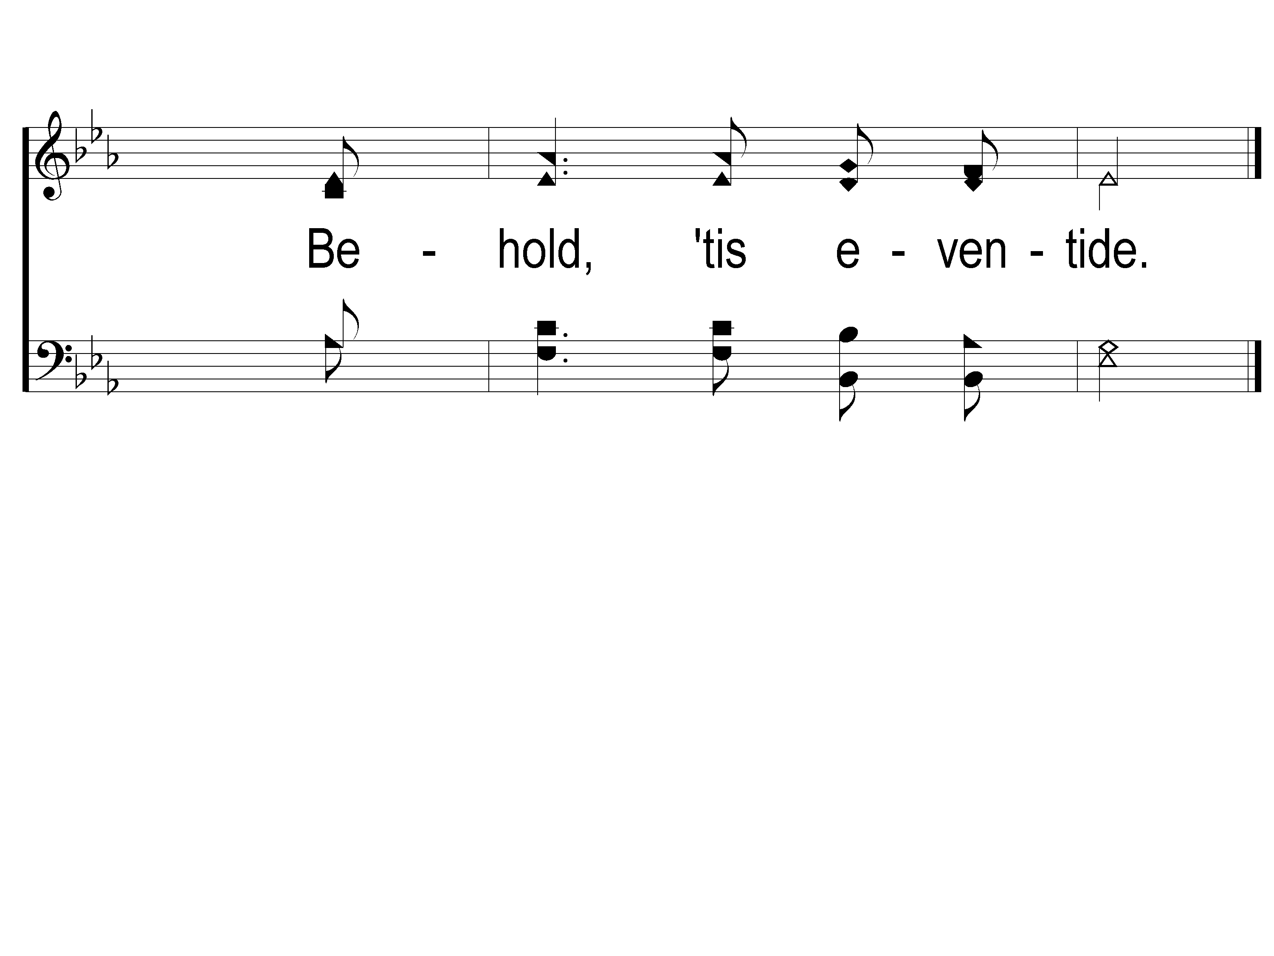
C-2 Abide with Me Tis Eventide
Abide With Me; ‘Tis Eventide
34
ePraise Hymn Presentation © 2005 Taylor Publications

Slide 5
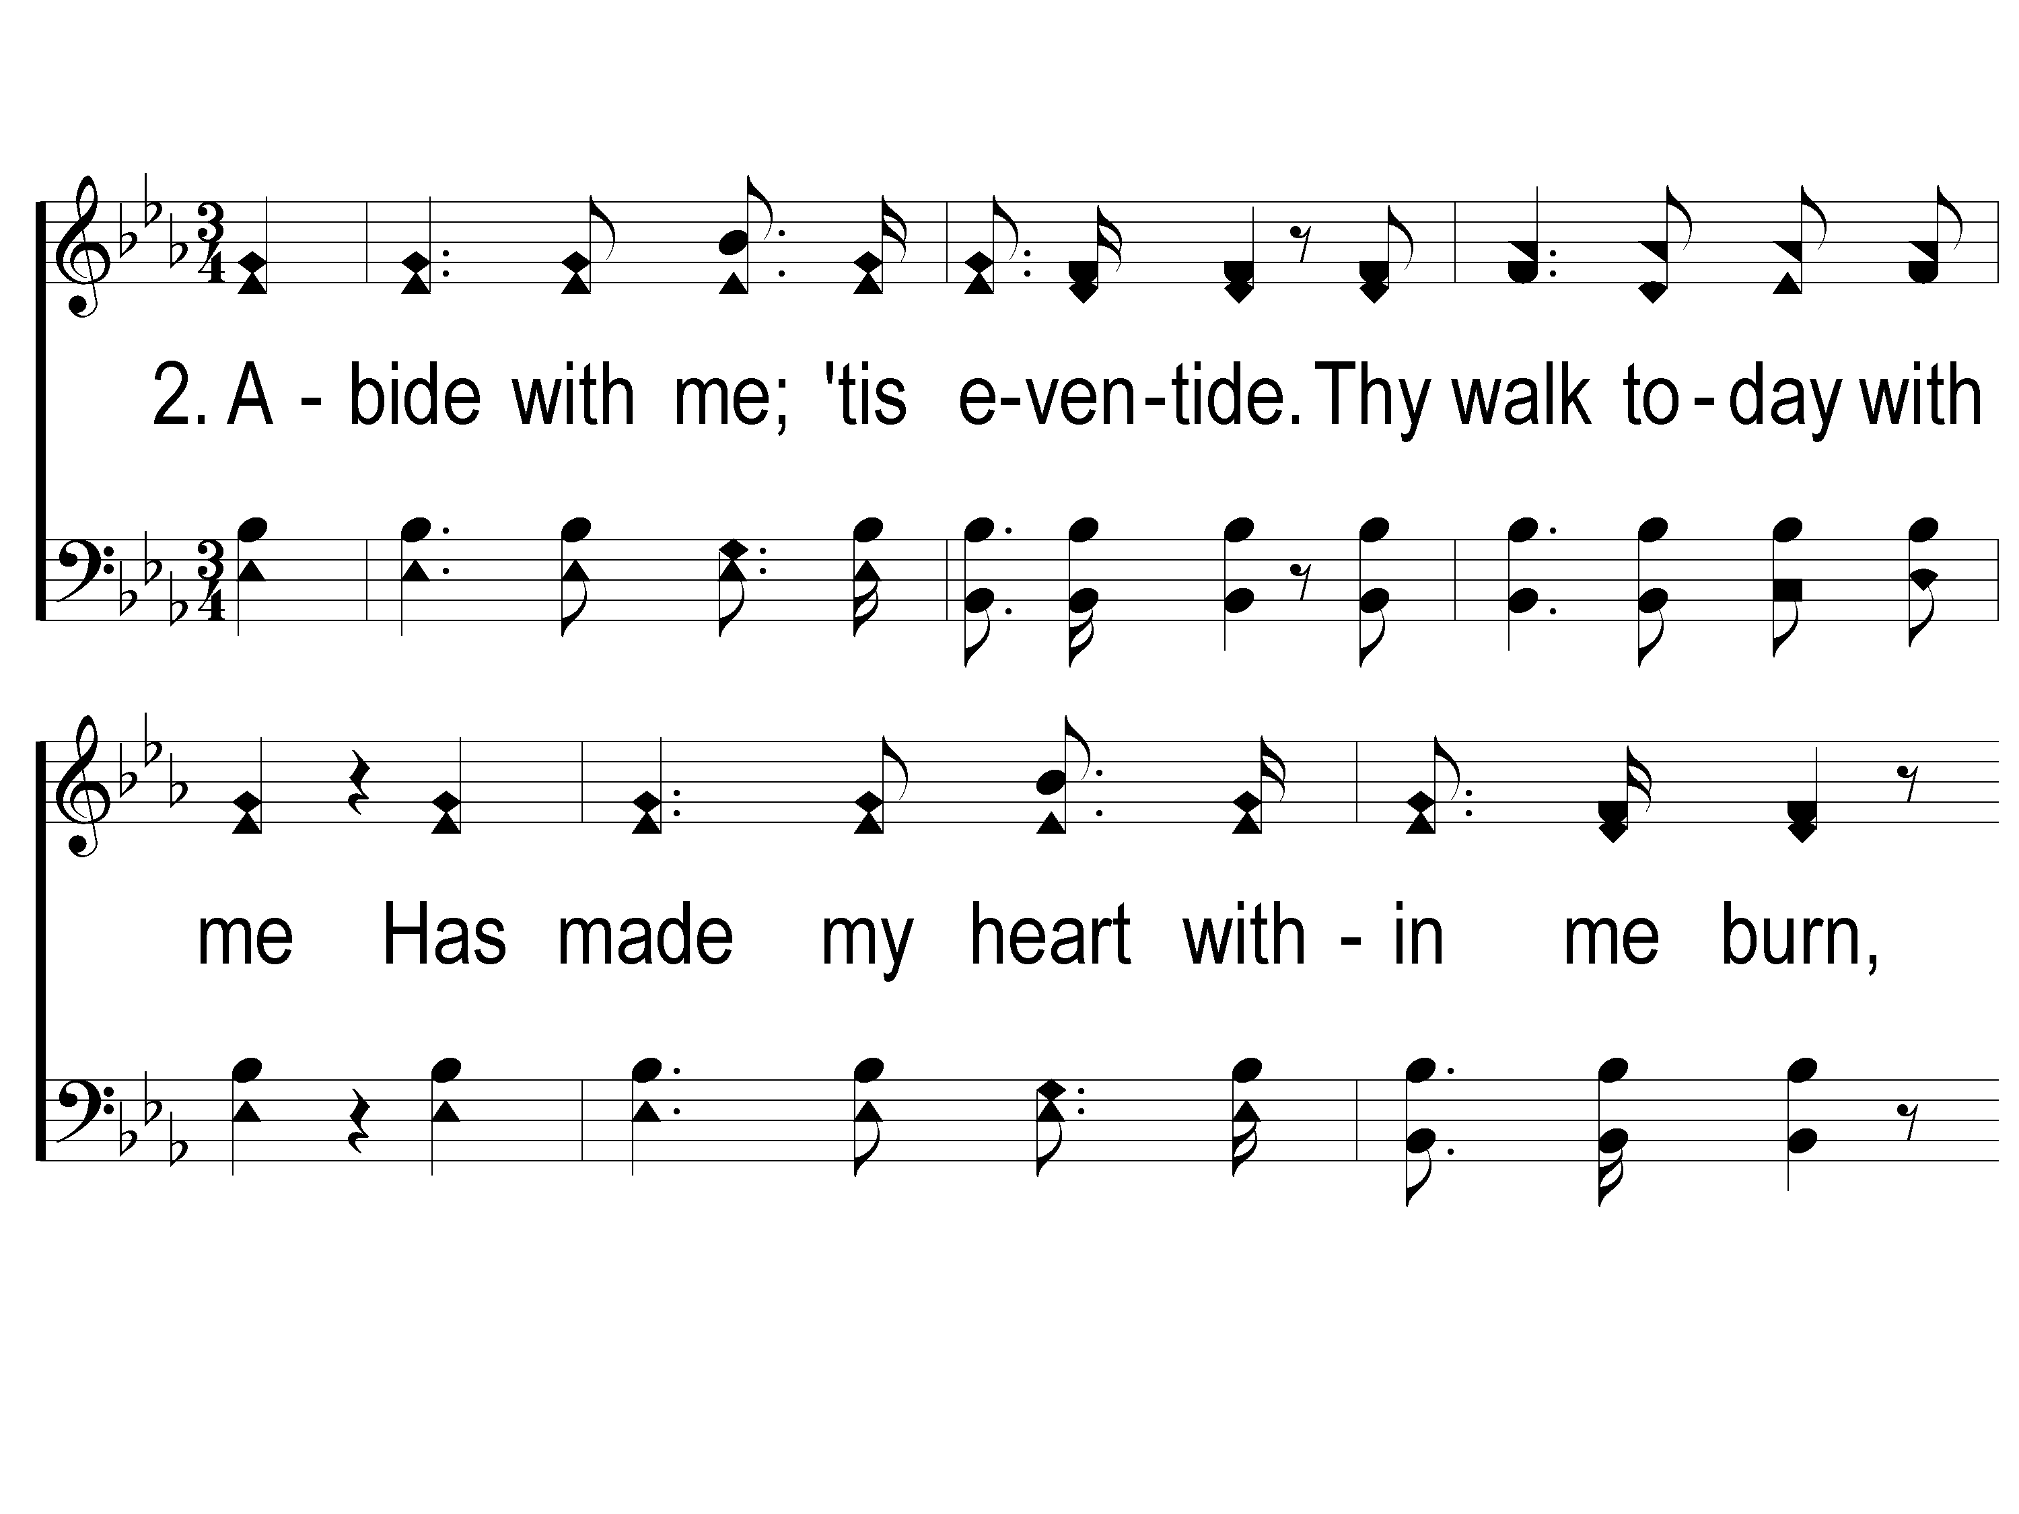
2-1 Abide with Me Tis Eventide
Abide With Me; ‘Tis Eventide
34
ePraise Hymn Presentation © 2005 Taylor Publications

Slide 6
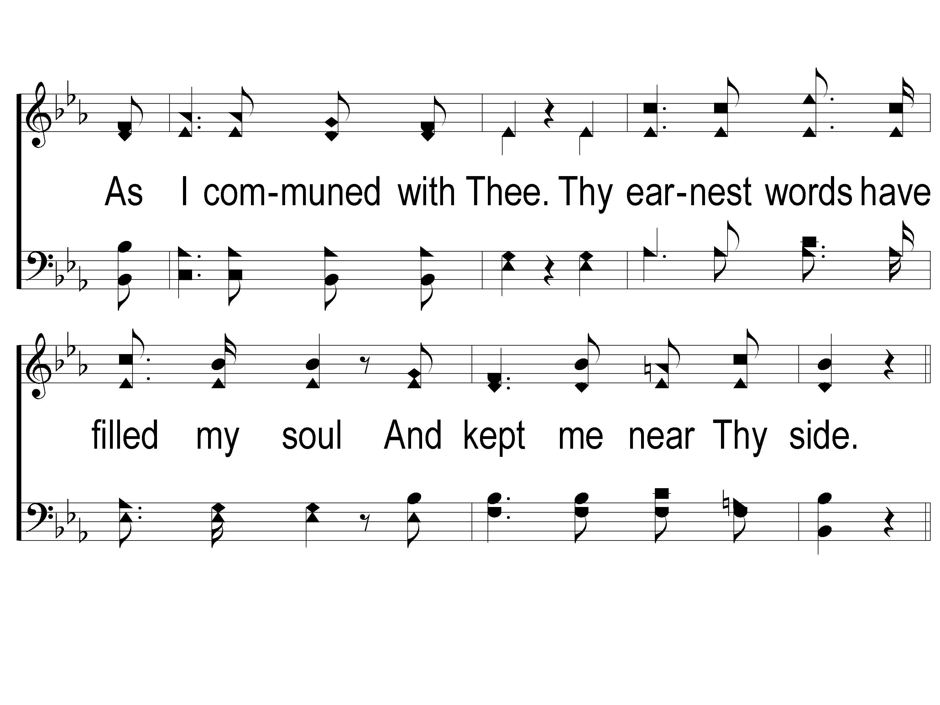
2-2 Abide with Me Tis Eventide
Abide With Me; ‘Tis Eventide
34
ePraise Hymn Presentation © 2005 Taylor Publications

Slide 7
C-1 Abide with Me Tis Eventide
Abide With Me; ‘Tis Eventide
34
ePraise Hymn Presentation © 2005 Taylor Publications

Slide 8
C-2 Abide with Me Tis Eventide
Abide With Me; ‘Tis Eventide
34
ePraise Hymn Presentation © 2005 Taylor Publications

Slide 9
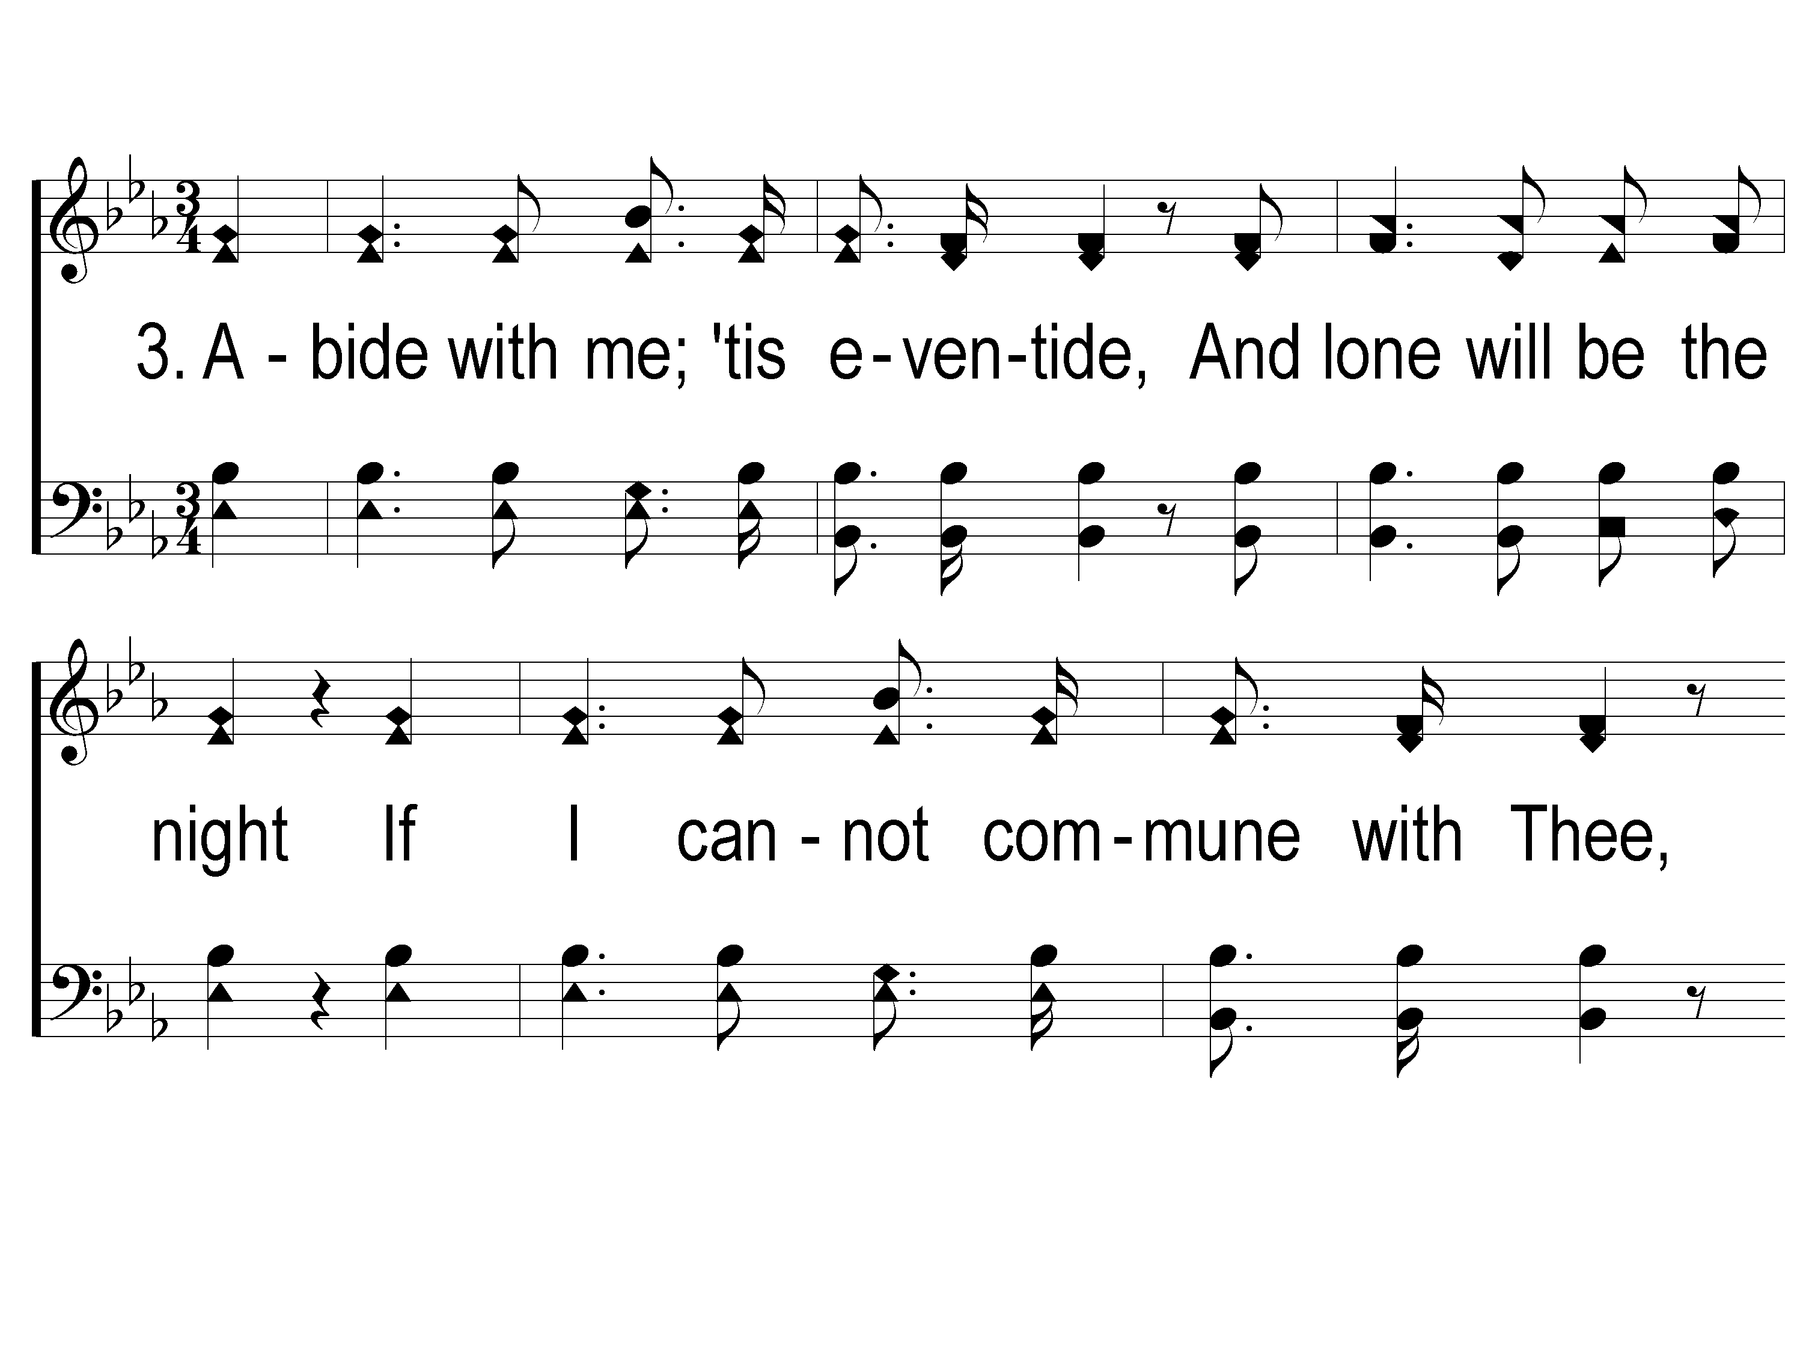
3-1 Abide with Me Tis Eventide
Abide With Me; ‘Tis Eventide
34
ePraise Hymn Presentation © 2005 Taylor Publications

Slide 10
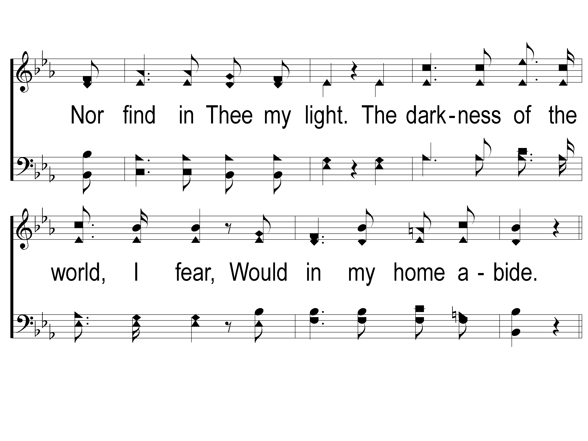
3-2 Abide with Me Tis Eventide
Abide With Me; ‘Tis Eventide
34
ePraise Hymn Presentation © 2005 Taylor Publications

Slide 11
C-1 Abide with Me Tis Eventide
Abide With Me; ‘Tis Eventide
34
ePraise Hymn Presentation © 2005 Taylor Publications

Slide 12
C-2 Abide with Me Tis Eventide
Abide With Me; ‘Tis Eventide
34
ePraise Hymn Presentation © 2005 Taylor Publications

